Slide 1
Great Open Source Compliance For Everyone

Slide 2

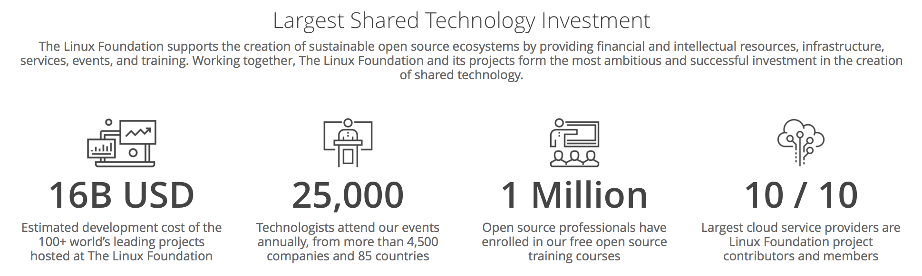
Notes:
To provide context for the OpenChain Project we need to look at the larger world of open source. The Linux Foundation, which hosts the OpenChain Project, also hosts 100 other projects driving open source adoption. Most of the projects create code, some create governance and compliance information. We are looking at 16 billion USD of collaborative development and tens of thousands of contributors alongside over 1,000 supporting companies.

Slide 3
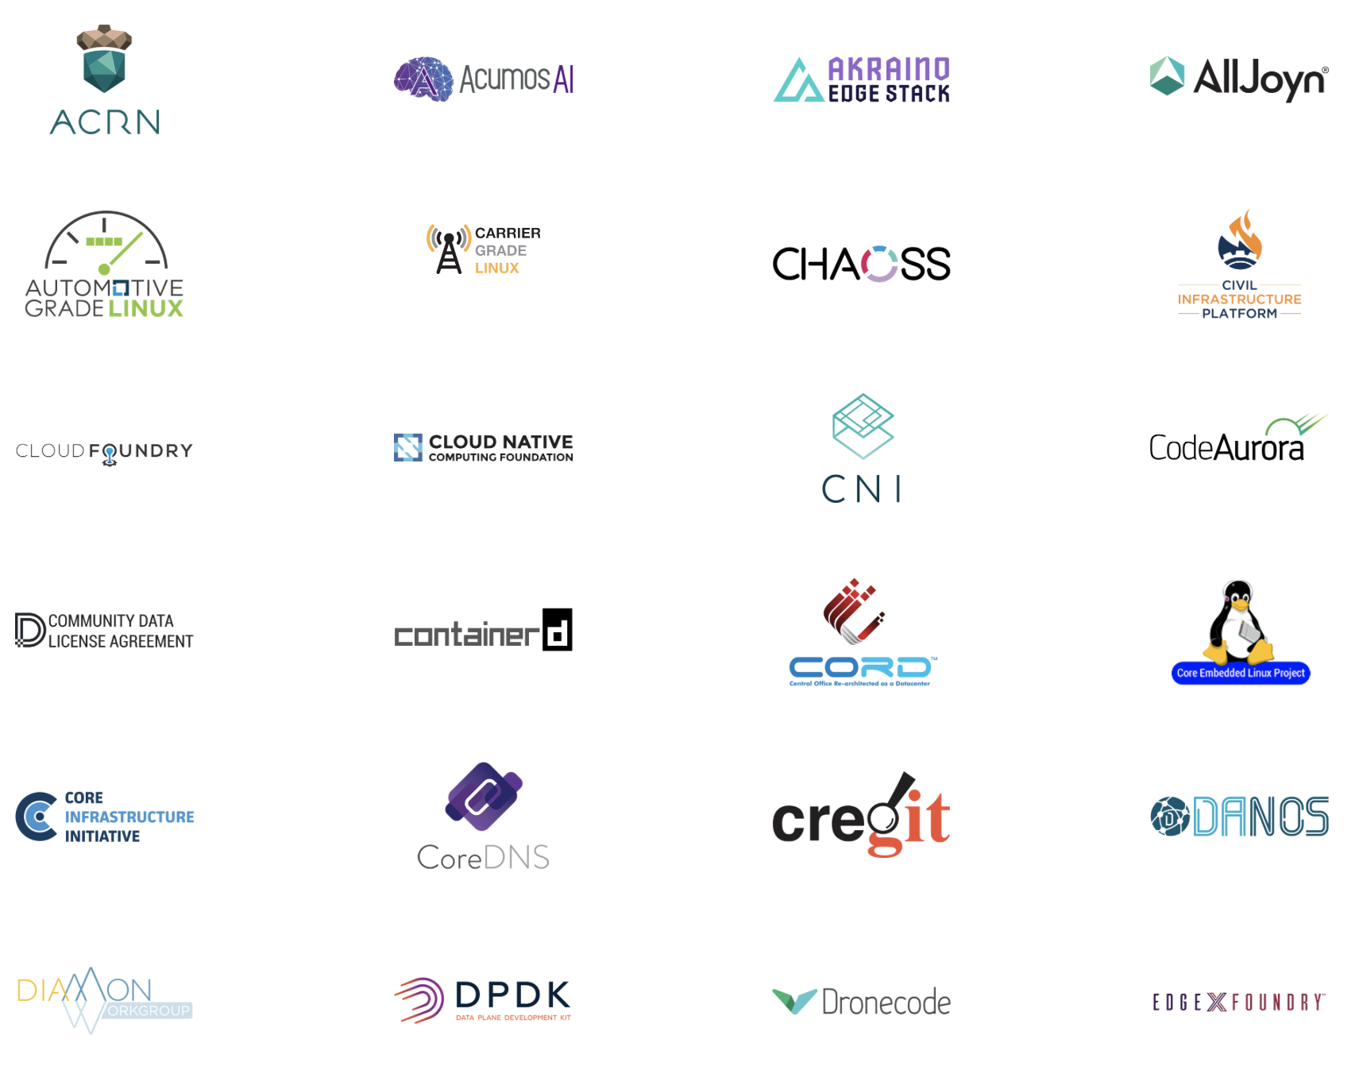
Notes:
Here is a whistlestop tour of Linux Foundation projects. We are not going to dwell on any single project. We are looking at scale.

Slide 4
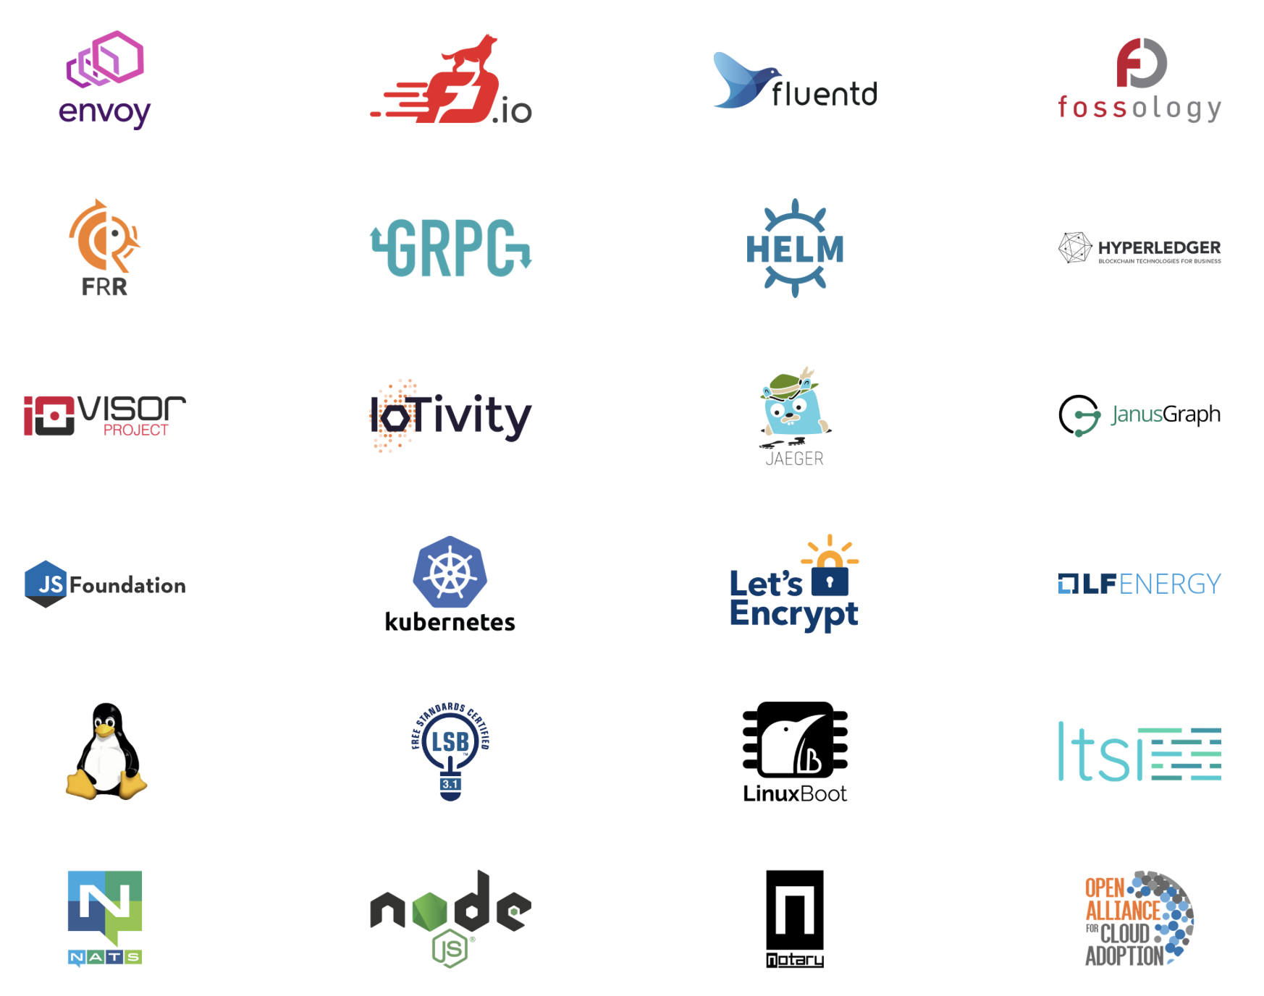
Notes:
Here’s more.

Slide 5
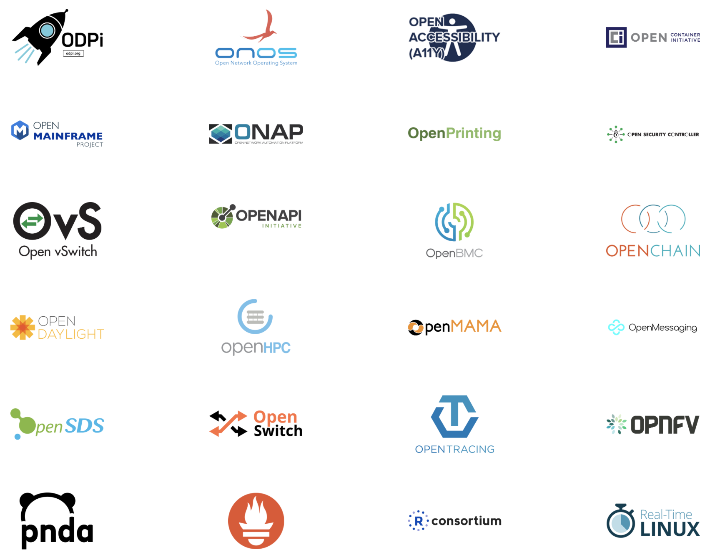
Notes:
And more.

Slide 6
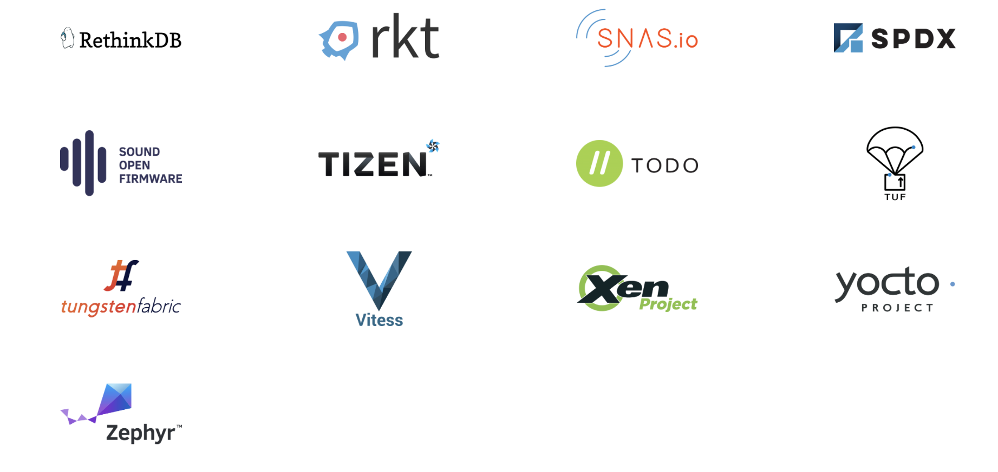
Notes:
And finally even more.

Slide 7
Compliance – A gateway to access
Notes:
Open source license compliance is a gateway to accessing projects like these. It is gateway to 16 billion dollars of code, platforms that can accelerate any market.

Slide 8
Let’s provide business context
Notes:
There is a clear business context for compliance. While often characterized as a boring legal matter, compliance is core to effective strategic engagement with open source technology.

Slide 9
The internal company dialogue…
Notes:
Let’s illustrate this with an internal company dialogue.

Slide 10
We use Open Source and get billions of dollars of code
Notes:
We use Open Source and get billions of dollars of code

Slide 11
This code was created by other people
Notes:
This code was created by other people

Slide 12
How we respect their rights?
Notes:
How we use respect their rights?

Slide 13
How do we meet our legal requirements?
Notes:
How do we meet our legal requirements?

Slide 14
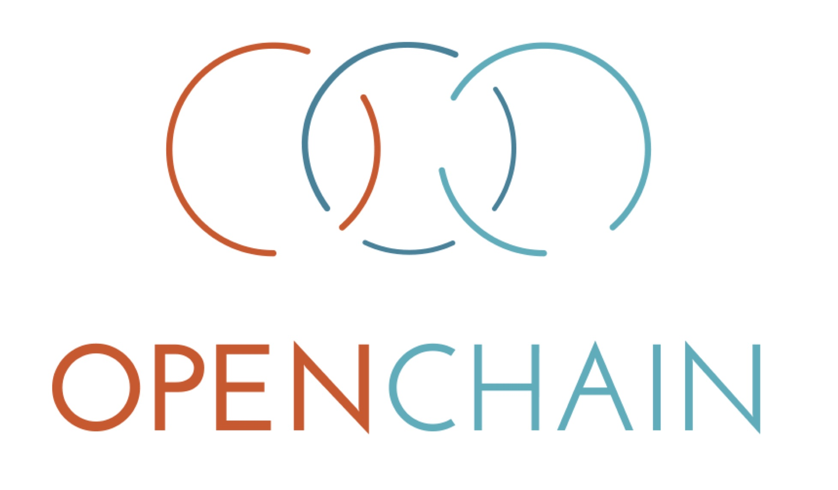




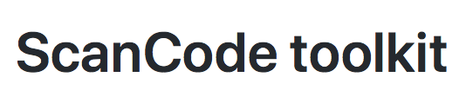
Welcome To The Stack
Notes:
The OpenChain Project is a key part of answering the questions raised in this dialogue. At the heart of the OpenChain Project is a specification, an overarching standard for how companies deal with open source compliance. This is the top level: a list of the overarching processes, policies and training companies need.

Slide 15
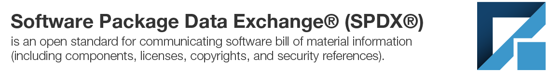
https://www.spdx.org
Notes:
Just below this we see SPDX, a sister standard which provides a software bill of materials, a key component in realizing some of the processes companies use to manage open source compliance.

Slide 16
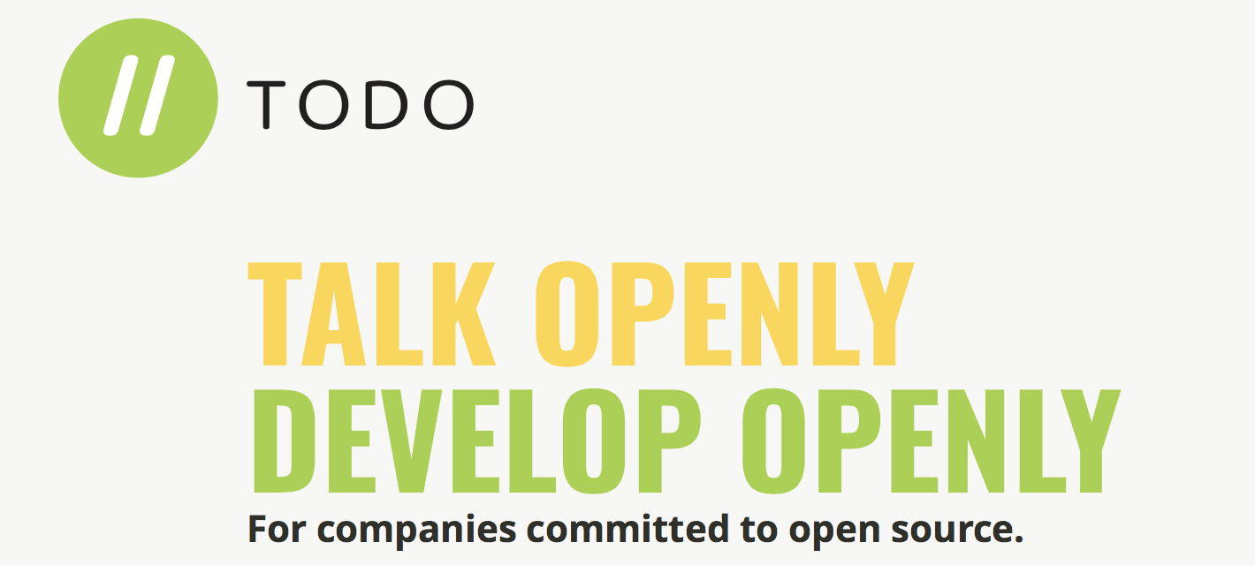
http://www.todogroup.org
Notes:
Adjacent are projects like TODO Group, providing excellent material regarding how to create and manage open source program offices, which are often another key component in realizing some of the processes companies use to manage open source compliance.

Slide 17
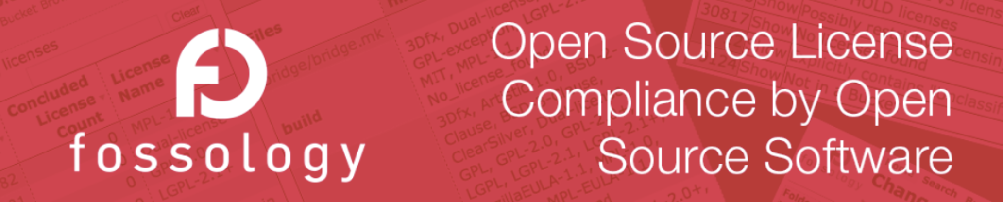
https://www.fossology.org
Notes:
Below this we see projects providing tooling to accomplish the specifics of various process steps. A great example is FOSSology, a project that allows you to scan source code and see what licenses are being used.

Slide 18
Welcome To The Stack
Notes:
Let’s pull back. So there is a stack of great projects to help companies go from the top level to the details of open source compliance. Our focus today is at the very top, the standard that defines what the overall key requirements of a quality open source compliance program are. We are looking at the OpenChain Project.

Slide 19
“How do I trust my open source supply chain?”
Notes:
The OpenChain Project asks one simple question. “How do I trust my open source supply chain?” Answering that question provides a way to increase efficiency and reduce resource costs around open source compliance.

Slide 20
OpenChain Adoption – A Story of Levels
Level1
NOT understand
Importance of
OSS Compliance
Level2
NOT understand
what to do
Level3
NOT understand
how to do
Level4
Not Understand
how to get
certification
●Join events
for Engineers/
Legal people/
IP people
●Workshop
●Consultation
●Self
certification
support
●Reference Material
(Wiki/
Handbook/
Academic
paper)
●Training
support
●Third-party
certification
●PR:
Traditional
Media/
Tech Media/
SNS
Notes:
OpenChain Conformance, meeting all the requirements of the OpenChain standard – we call it the Specification – is at the end point of an important journey for companies. This journey was described by Toyota as having four parts.
First, a company may not understand the important of open source compliance. Second, they might not understand what to do about compliance. Third, they might understand what to do, but not how to do it. And finally, a company may not understand how to get certification, to confirm they are meeting international expectations.

Slide 21
There are three parts to OpenChain Project:
Specification
Conformance
Curriculum
Notes:
There are three parts of the OpenChain Project that support this evolution.
The Specification and Conformance to the Specification are around level 4, towards the end point of the journey.
The Curriculum – a library of supportive reference material – is able to help people get through levels 1 through 3.

Slide 22
The OpenChain Specification defines the requirements for a quality compliance program.
Notes:
For the context of this talk the most important thing to remember is that the OpenChain Specification defines the requirements for a quality compliance program.

Slide 23
Training
Policy
Process
Inbound
Outbound
Notes:
It defines the big picture, showing the inflection points where a company should have processes, policies or training.

Slide 24
The OpenChain Specification confirms a company has open source processes, policies and training.
Companies have the flexibility to decide each specific process, policies and training.
Notes:
The OpenChain Specification confirms a company has open source processes, policies and training.
Companies have the flexibility to decide each specific process, policies and training.

Slide 25
Common requirements for suppliers and customers makes everything simpler.
Learn more here: https://www.openchainproject.org/spec
Notes:
By adoption the key requirements we suddenly have much better clarity about what to do or what is being done. It makes the open source compliance part of supplier and customer relationships much more effective.

Slide 26
OpenChain Conformance allows organizations to show they meet these requirements.
Notes:
OpenChain Conformance allows organizations to show they meet these requirements. It provides the practical “yes/no” questions that help a company confirm it meets the OpenChain Specification.

Slide 27
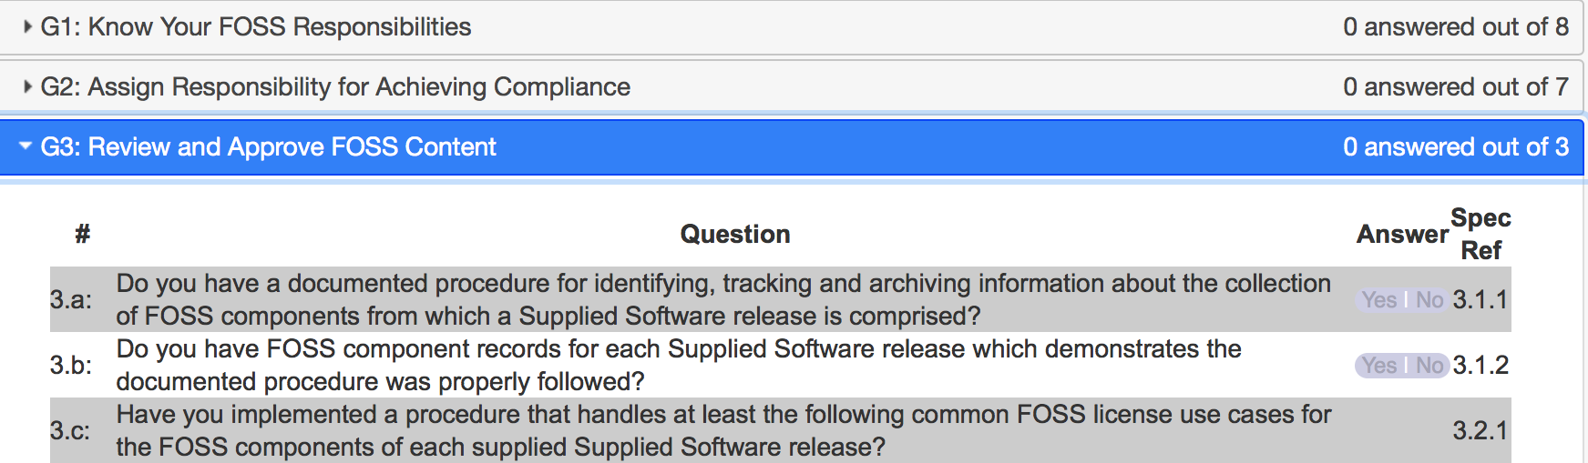
Notes:
Here is a clear example from our online Conformance web app. This app allows companies to self-certify to the OpenChain Specification.
There are five “Goals” – following the structure of the Specification – and each goal is accomplished by answering the questions contained inside. For example, Goal 3 contains three yes or no questions.

Slide 28
If a company can answer Yes to each question they are OpenChain Conformant.
Learn more here: https://www.openchainproject.org/conformance
Notes:
The exciting thing is how easy this is. If a company can answer Yes to each question they are OpenChain Conformant. This is a process companies can go through at their own pace and in private on the online Web App. Their conformance is only made public after they have passed the questionnaire and finalize their self-certification.

Slide 29
The OpenChain Curriculum provides reference open source processes and solutions.
Learn more here: https://www.openchainproject.org/curriculum
Notes:
Now, to support this journey – especially around filling in the gaps identified when going through the OpenChain Conformance process – companies can use the library of material in the OpenChain Curriculum.

Slide 30
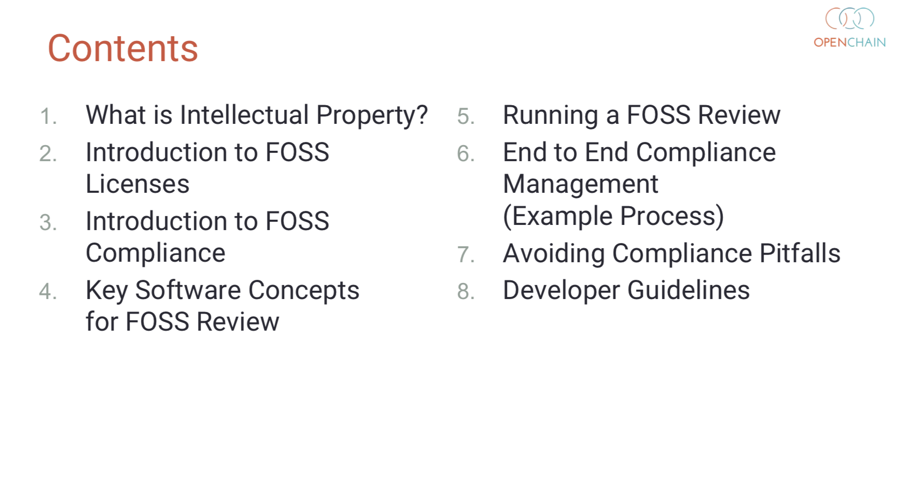
Notes:
Here is an example of our training slides. In eight chapters and 80 slides we have reference material guiding people from “what is intellectual property” to “developer guidelines.” This reference slide deck can be used by companies to help support their internal training.

Slide 31
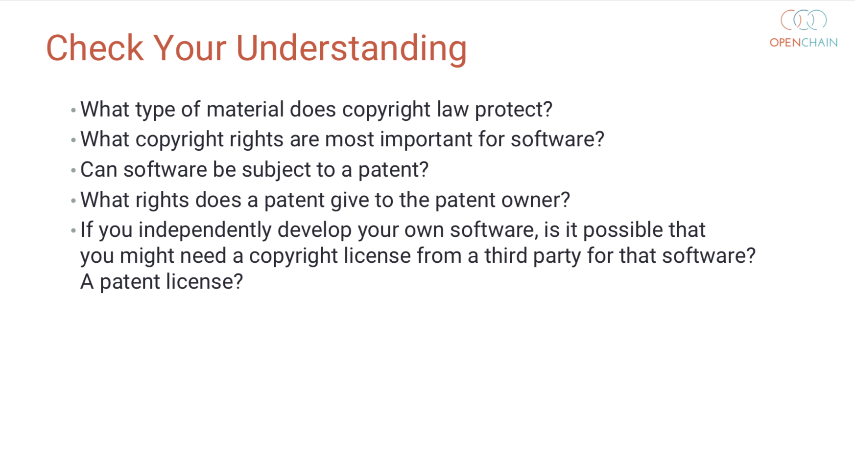
Notes:
Even though the deck is a compact 80 slides it also contains a simple and useful open source compliance exam. The end of all eight chapters have a set of “check your understanding” questions. Put all eight sections together and you have a great reference exam.

Slide 32
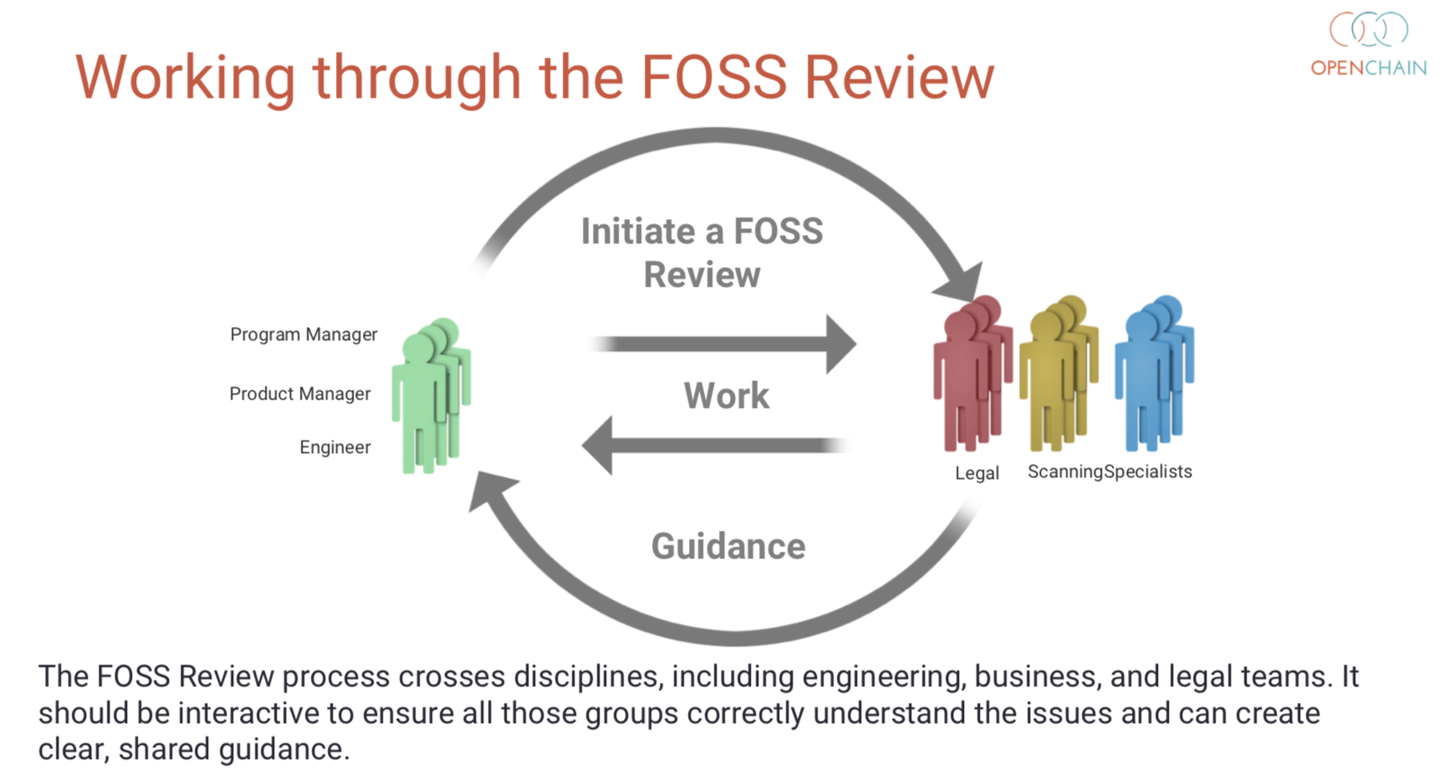
Notes:
Before we move on I want to show you a slide from the reference training deck. This is an open source compliance review process for a large company. As you can see it involves project managers, engineers, legal personnel and scanning specialists. This type of example helps large entities and multinationals frame approaches to open source compliance. Alongside these we also have great examples more suitable for small to medium entities.

Slide 33
The OpenChain Curriculum can be used for any open source training program.
Learn more here: https://www.openchainproject.org/curriculum
Notes:
The OpenChain Curriculum can be used for any open source training program. We have released all the reference material under CC-0 licensing, effectively public domain. That’s important because it means companies, consultancies and NGOs can use the material for any purpose, even outside of OpenChain Conformance.

Slide 34
The goal is to build trust by having organizations conformant with the OpenChain Specification.
Notes:
Now, naturally our overall goal in the OpenChain Project is to encourage OpenChain Conformance. We want people to meet the requirements of the OpenChain Specification and we have built a healthy community to explain the value here, to support new participants and to champion great open source compliance.

Slide 35
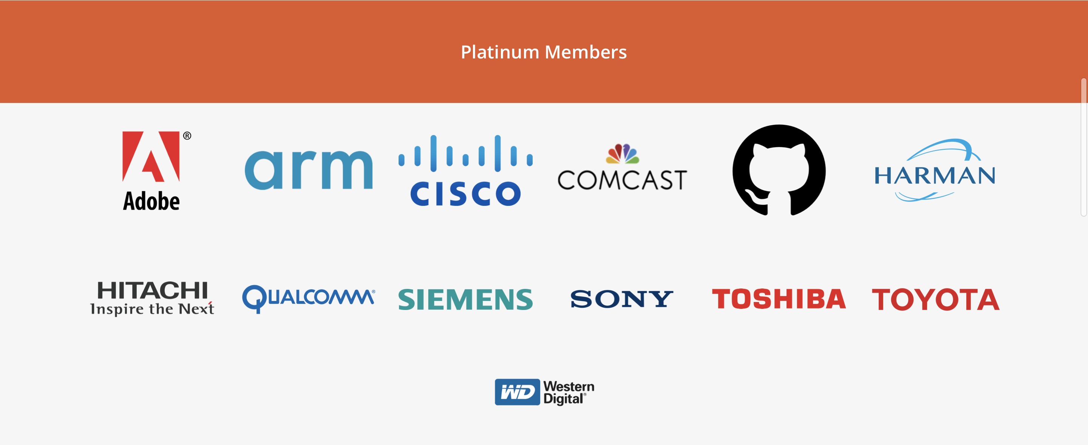
Notes:
There are a series of Platinum Member companies in the OpenChain Project. As you can see, they are pretty diverse, with Adobe standing shoulder to shoulder with Toyota in establishing this standard for open source compliance.
Toshiba is our newest member, a new partner for building out in the global procurement cycle.

Slide 36
Scale of Platinum Members:
Over $750 Billion of Revenue
Notes:
Our current membership represents combined revenue of over 750 billion USD and a commensurately large impact on global procurement.

Slide 37
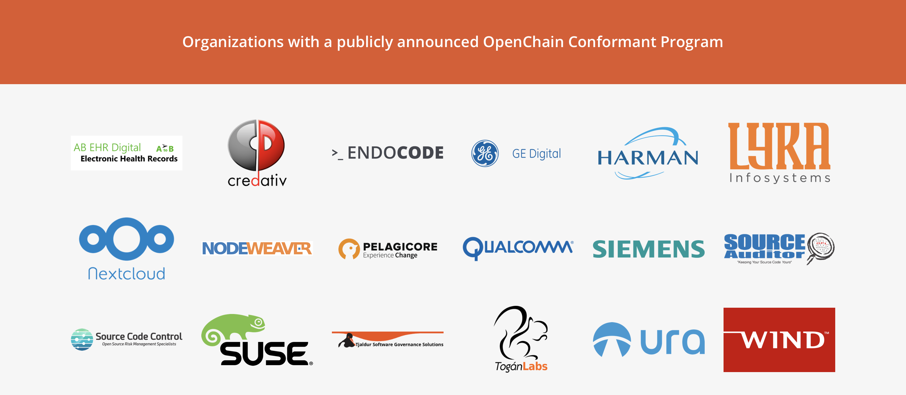
Notes:
The OpenChain Project also has a growing community of organizations with a publicly announced OpenChain Conformant program. These companies range from the beginning to the end of global supply chains, with SUSE being the latest organization to announce conformance.

Slide 38
Work Teams supporting OpenChain:
Specification - Chaired by Mark Gisi (Wind River)
Conformance - Chaired by Miriam Ballhausen (SCA)
Curriculum - Chaired by Alexios Zavros (Intel)
Onboarding - Chaired by Nathan Kumagai (Qualcomm)
Notes:
The community is very inclusive and all of our day to day work is done via work teams that meet via phone twice a month. We do a lot of our work on these calls – where we publish slides and minutes – and we also do a lot of work on our mailing lists. Everyone is welcome to both. Indeed, we are actively seeking knowledge and contributors from all over the world. We are building a global standard and we want it to have a comprehensive global perspective.

Slide 39

Notes:
Ultimately the OpenChain Project is all about people. A wide range of contributors from organizations of all types and sizes collaborate to make open source compliance as simple, as comprehensive and as efficient as possible.

Slide 40
Progress Since Last Year
International Partners - from law firms to certification authorities
  Example: Moorcrofts - UK
  Example: TÜV SÜD - Germany and Japan
Significant New Board Members
  Example: Toshiba (more announcements shortly)
Significant New Community Members
  Example: Microsoft
  Example: Panasonic
A More towards formal standardization
  Most likely PAS process for ISO - Launch ETA Q1 2020

Slide 41
Coming Soon
New Board Member Announcements
New Conformant Organization Announcements
New Partnership Announcements
Increasingly Powerful Positioning for Procurement
  Standardization
  Deployment by board members
  Deployment by community members

Slide 42
Be part of this
Join the community:
https://www.openchainproject.org/community
Self-certify your organization:
https://certification.openchainproject.org
Notes:
You are invited to be part of this. You can join our community by visiting our website, subscribing to a mailing list, or hopping on one of our calls. You can also access the self-certification web-app and check how your current overarching processes map to international norms. Naturally that is completely private until you want to declare OpenChain Conformance.

Slide 43
Questions?
Notes:
And that’s it. OpenChain is the standard that explains the key requirements of quality open source compliance programs. It is open, it has a vibrant community, and we want to work with you. Thank you so much for your time. Any questions?

